Slide 1
The correlation between Receiver optical position and scattering region

Slide 2
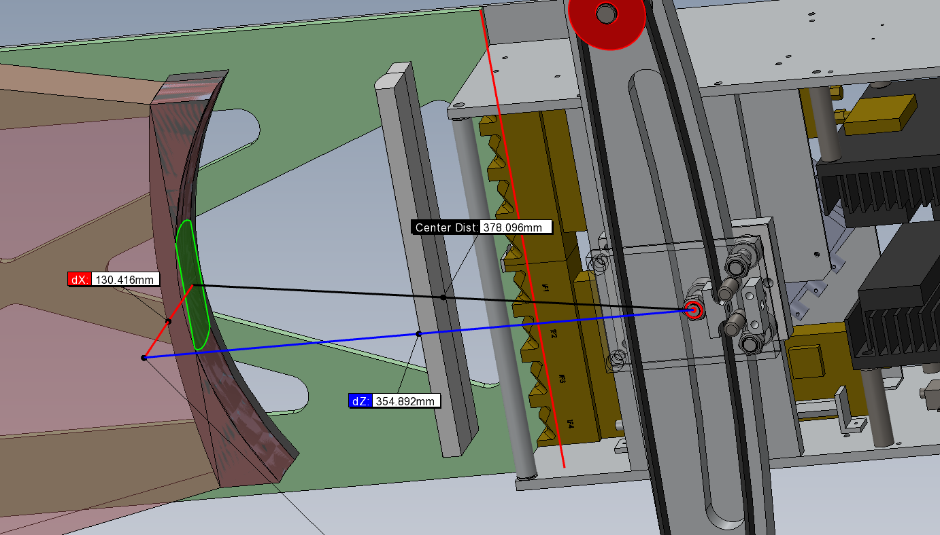
Parameters waiting to check
Distance from carriage tilt axis to lens:354.892mm，

Slide 3


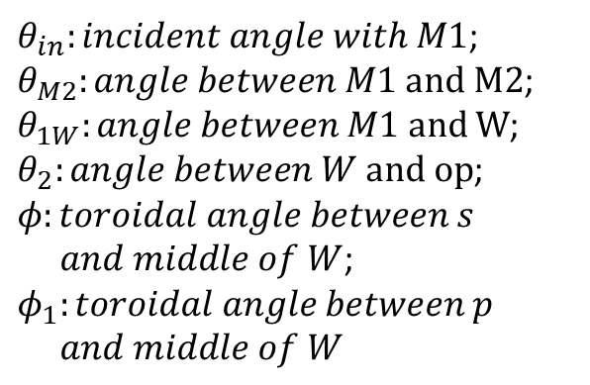




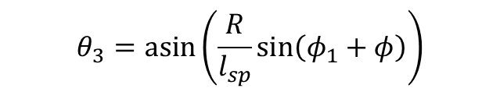











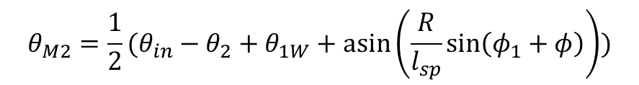
$$θ_{M2} derivation$$
$θ_{in}:incident angle with M1$;
$θ_{M2}:angle between M1 and M2$;
$θ_{1W}:angle between M1 and W$;
$θ_{2}:angle between W and op$;
$$φ:toroidal angle between s$$
$and middle of W$;
$$φ_{1}:toroidal angle between p$$
$and middle of W$
$$o$$
$$M1$$
$$θ_{in}$$
$$θ_{in}−θ_{M2}=θ−θ_{1W}+θ_{M2}$$
$$φ_{1}$$
$$φ$$
$$R$$
$$θ=θ_{2}−θ_{3}$$
$$θ_{3}=\operatorname{asin}\left(\frac{R}{l_{sp}}\sin\left(φ_{1}+φ\right)\right)$$
$$R_{m}$$
$$θ_{2}$$
s
$$M2$$
$$l_{sp}^{2}=R_{m}^{2}+R^{2}−{2R}_{m}R∗cos⁡\left(φ_{1}+φ\right)$$
$$θ_{3}$$
$$θ$$
$$θ_{M2}$$
$$W$$
$$p$$
$$θ_{M2}=\frac{1}{2}(θ_{in}−θ_{2}+θ_{1W}+\operatorname{asin}\left(\frac{R}{l_{sp}}\sin\left(φ_{1}+φ\right)\right))$$
$$θ_{1W}$$

Slide 4
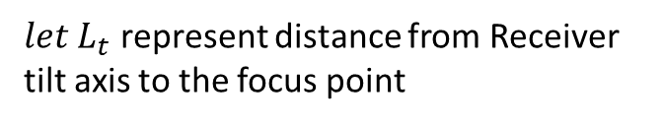

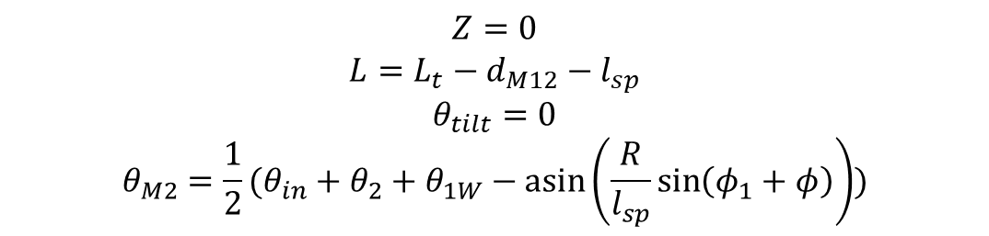


S on the middle plane of TOKAMAK
$$s(R,φ,z=0)$$
$$o$$
$let L_{t}$ represent distance from Receiver tilt axis to the focus point
$$M1$$
$$θ_{in}$$
$$φ$$
$$φ_{1}$$
$$R$$
$$Z=0$$
$$L=L_{t}−d_{M12}−l_{sp}$$
$$θ_{tilt}=0$$
$$θ_{M2}=\frac{1}{2}(θ_{in}+θ_{2}+θ_{1W}−\operatorname{asin}\left(\frac{R}{l_{sp}}\sin\left(φ_{1}+φ\right)\right))$$
$$R_{m}$$
$$θ_{2}$$
s
$$M2$$
$$θ_{3}$$
$$θ$$
$$θ_{M2}$$
$$p$$
$$W$$
L is the distance from Receiver tilt axis to M1
$$θ_{1W}$$

Slide 5






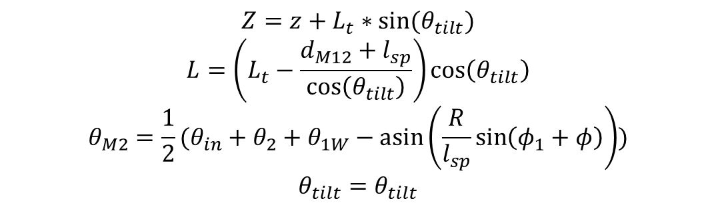










S away from the middle plane of TOKAMAK
$$s(R,φ,z≠0)$$
$$o$$
$$M1$$
$$θ_{in}$$
$$φ$$
$$φ_{1}$$
$$R$$
$$R_{m}$$
$$Z=z+L_{t}∗sin⁡(θ_{tilt})$$
$$L=\left(L_{t}−\frac{{d_{M12}+l}_{sp}}{\cos\left(θ_{tilt}\right)}\right)\cos\left(θ_{tilt}\right)$$
$$θ_{M2}=\frac{1}{2}(θ_{in}+θ_{2}+θ_{1W}−\operatorname{asin}\left(\frac{R}{l_{sp}}\sin\left(φ_{1}+φ\right)\right))$$
$$θ_{tilt}=θ_{tilt}$$
$$θ_{2}$$
s
$$M2$$
$$θ_{3}$$
$$θ$$
$$θ_{M2}$$
$$p$$
$$W$$
$$θ_{1W}$$

Slide 6

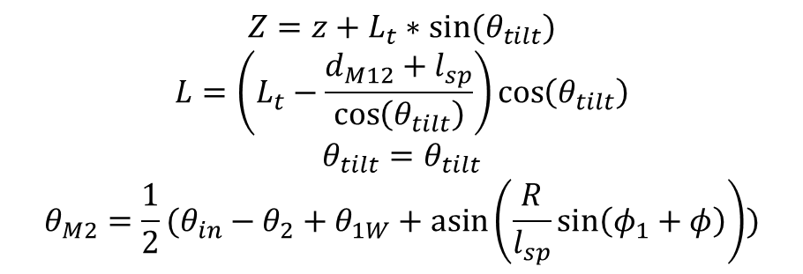

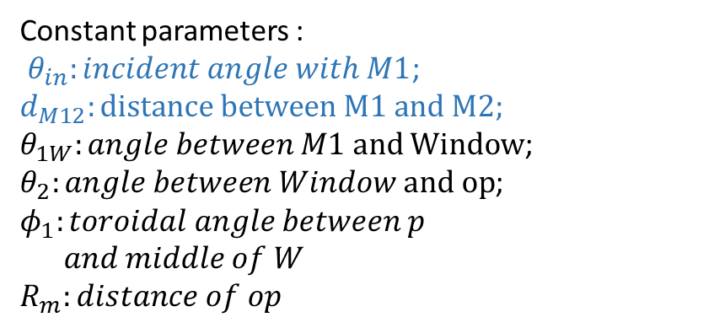
Backward
Known:$R,φ,z(Scattering region)$
Constant parameters :
$θ_{in}:incident angle with M1$;
$$d_{M12}:distance between M1 and M2;$$
$θ_{1W}:angle between M1 and Window$;
$θ_{2}:angle between Window and op$;
$$φ_{1}:toroidal angle between p$$
$and middle of W$
$$R_{m}:distance of op$$
$$o$$
$$M1$$
$$θ_{in}$$
$$φ$$
$$φ_{1}$$
$$R$$
$$Z=z+L_{t}∗sin⁡(θ_{tilt})$$
$$L=\left(L_{t}−\frac{d_{M12}+l_{sp}}{\cos\left(θ_{tilt}\right)}\right)\cos\left(θ_{tilt}\right)$$
$$θ_{tilt}=θ_{tilt}$$
$$θ_{M2}=\frac{1}{2}(θ_{in}−θ_{2}+θ_{1W}+\operatorname{asin}\left(\frac{R}{l_{sp}}\sin\left(φ_{1}+φ\right)\right))$$
$$R_{m}$$
$$θ_{2}$$
s
$$M2$$
$$θ_{3}$$
$$θ$$
$$θ_{M2}$$
$$p$$
$$W$$
$$θ_{1W}$$

Slide 7
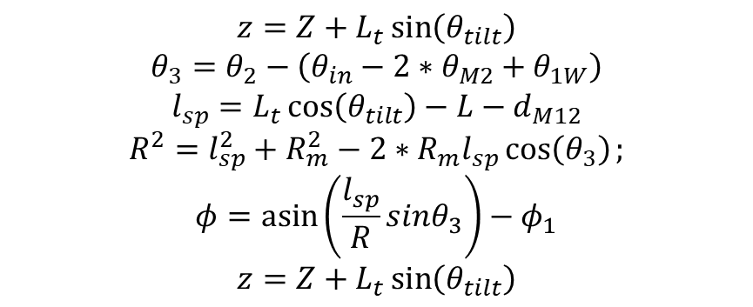

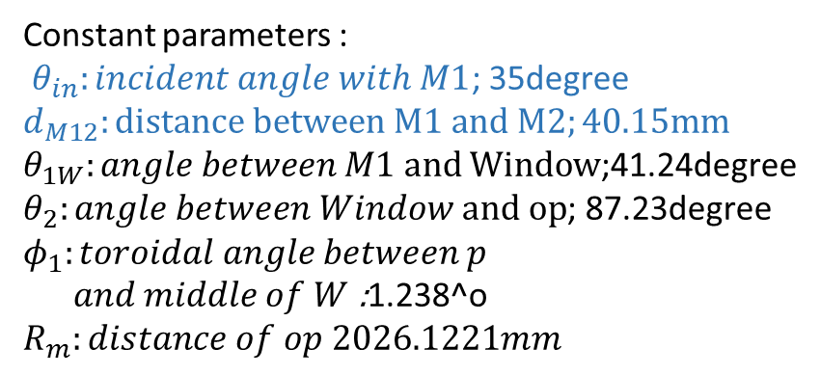
Forward
Known:$θ_{tilt},θ_{M2},Z,L$
Constant parameters :
$θ_{in}:incident angle with M1$; 35degree
$$d_{M12}:distance between M1 and M2;40.15mm$$
$θ_{1W}:angle between M1 and Window$;41.24degree
$θ_{2}:angle between Window and op$; 87.23degree
$$φ_{1}:toroidal angle between p$$
$and middle of W$ :1.238^o
$R_{m}:distance of op 2026.1221mm$
$$o$$
$$M1$$
$$θ_{in}$$
$$φ$$
$$φ_{1}$$
$$R$$
$$z=Z+L_{t}\sin\left(θ_{tilt}\right)$$
$$θ_{3}=θ_{2}−\left(θ_{in}−2∗θ_{M2}+θ_{1W}\right)$$
$$l_{sp}=L_{t}\cos\left(θ_{tilt}\right)−L−d_{M12}$$
$$R^{2}=l_{sp}^{2}+R_{m}^{2}−2∗R_{m}l_{sp}\cos\left(θ_{3}\right);$$
$$φ=\operatorname{asin}\left(\frac{l_{sp}}{R}sinθ_{3}\right)−φ_{1}$$
$$z=Z+L_{t}\sin\left(θ_{tilt}\right)$$
$$R_{m}$$
$$θ_{2}$$
s
$$M2$$
$$θ_{3}$$
$$θ$$
$$θ_{M2}$$
$$p$$
$$W$$
$$θ_{1W}$$

Slide 8
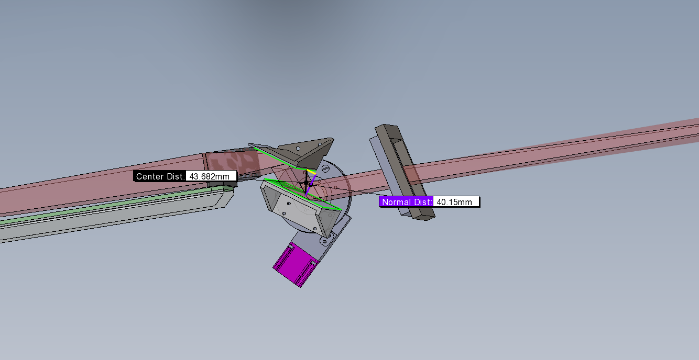


$$d_{M12}$$
$$d_{M12}=40.15mm$$

Slide 9
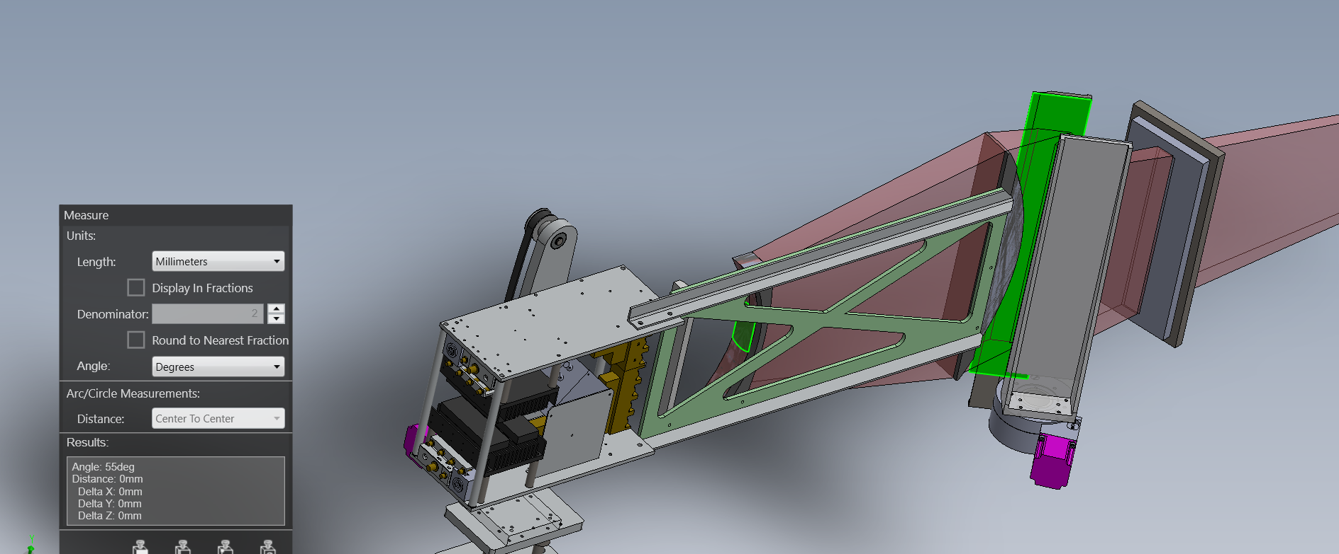

$$θ_{int}=90−55={35}^{o}$$

Slide 10
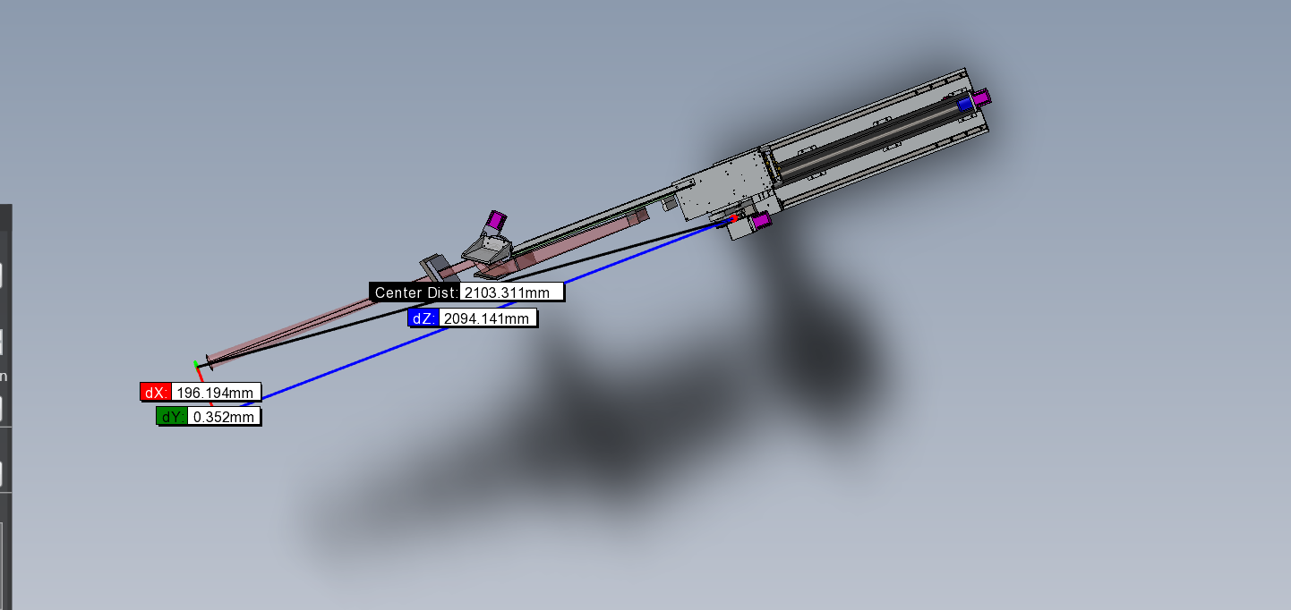
L_{T}=2094.141+40.15=2134.291mm

Slide 11



$$o$$
$$M1$$
$$θ_{in}$$
$$φ$$
$$φ_{1}$$
$$R$$
$$R_{m}$$
$$θ_{2}$$
s
$$M2$$
$$θ_{3}$$
$$θ_{M2}$$
$$θ$$
$$p$$
$$W$$
$$θ_{1W}$$

